Slide 1
Simple Linear Regression
Renato R. Maaliw III, DIT
College of Engineering
Southern Luzon State University
Lucban, Quezon, Philippines

Slide 2
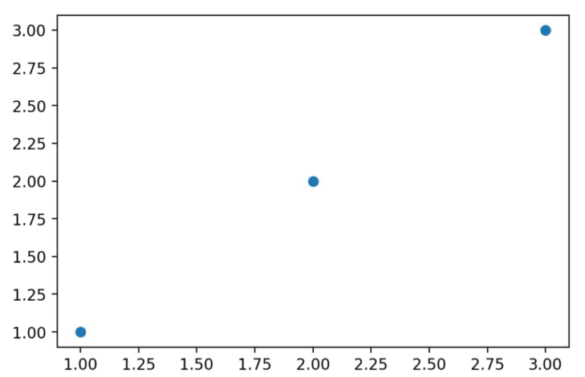
Linear Relationship
implies some constant straight-line relationship
simplest possible being y = x

Slide 3
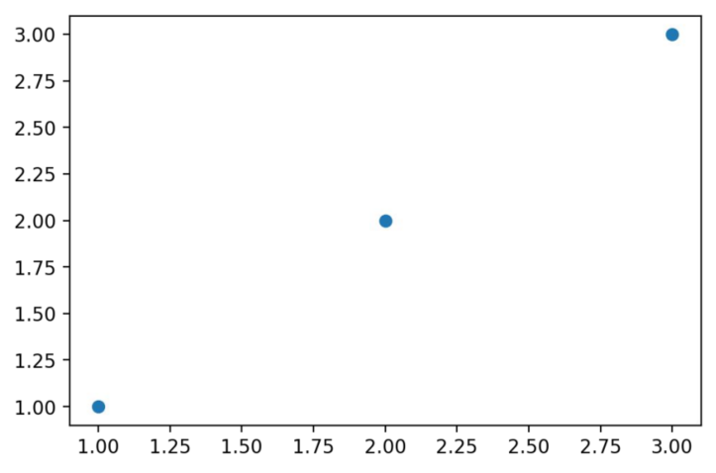
Here we see x = [1, 2, 3] and y = [1, 2, 3]

Slide 4
We could build out the relationship y = x as our “fitted” line

Slide 5
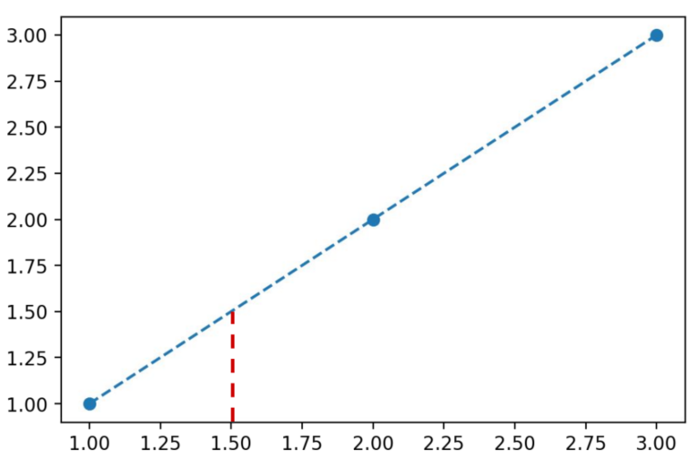
This implies for some new x value I can predict it is already related to y

Slide 6
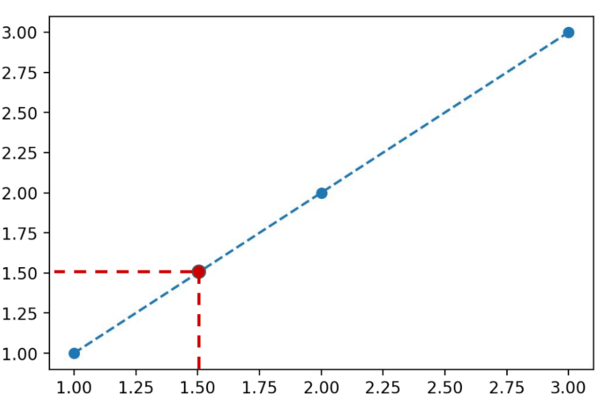
This implies for some new x value I can predict it is already related to y

Slide 7
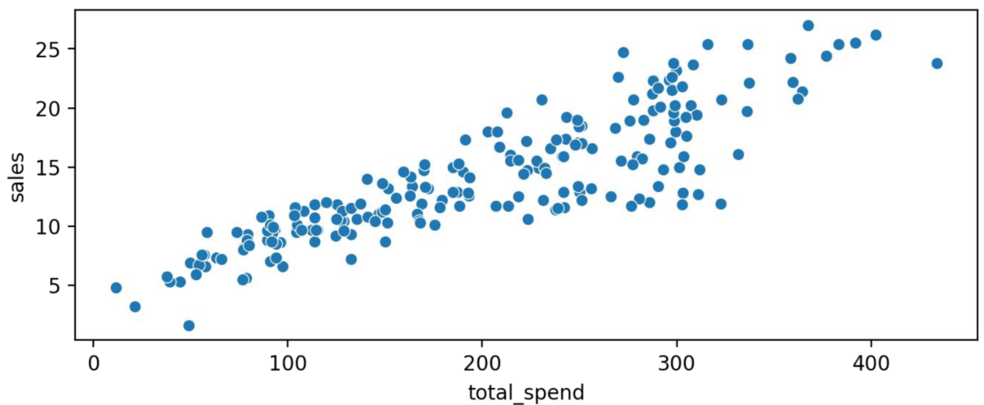
But what happens with real data? Where do we draw the line for this?

Slide 8
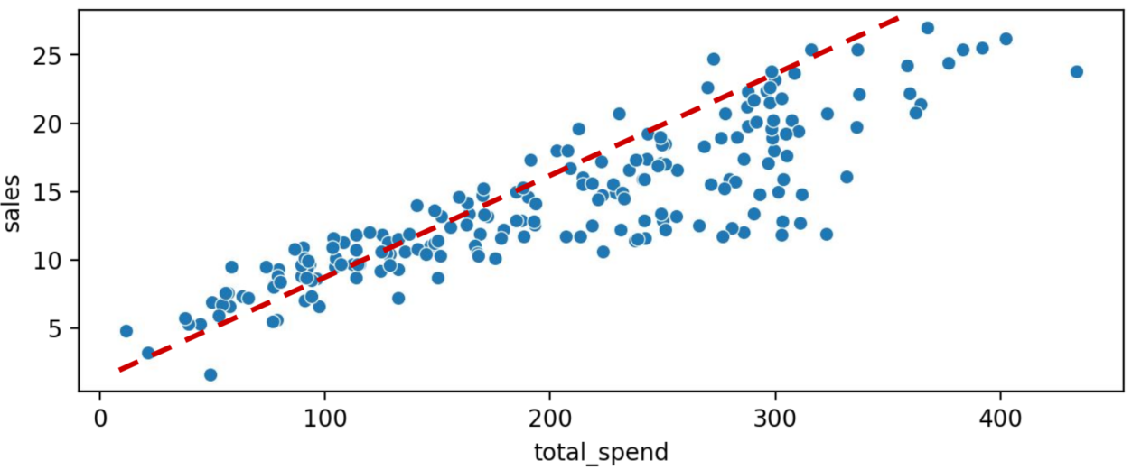
But what happens with real data? Where do we draw the line for this?

Slide 9
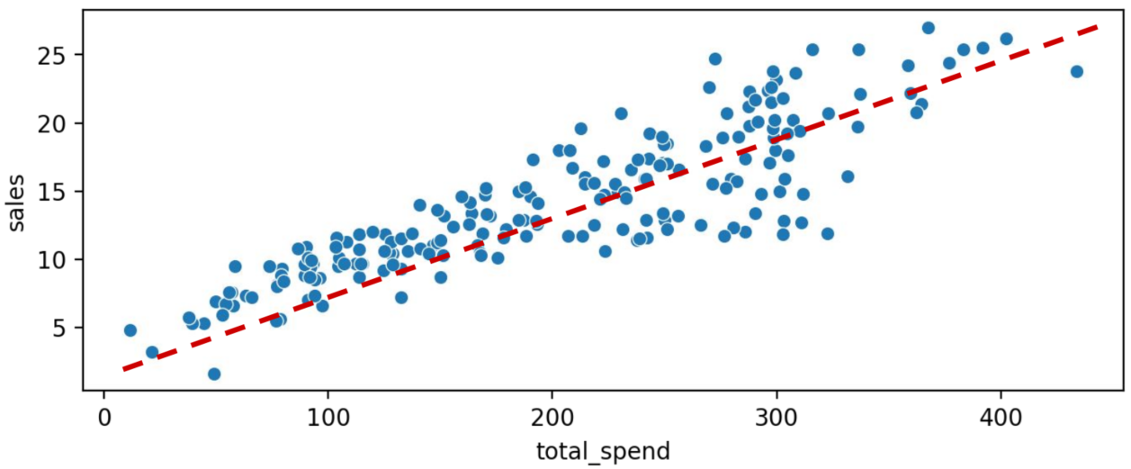
But what happens with real data? Where do we draw the line for this?

Slide 10
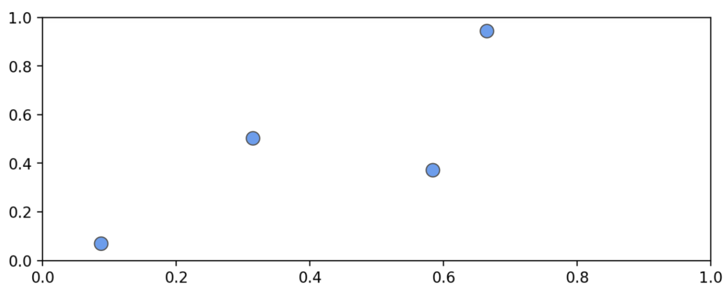
We understand we want to minimize the overall distance from the points to the line

Slide 11
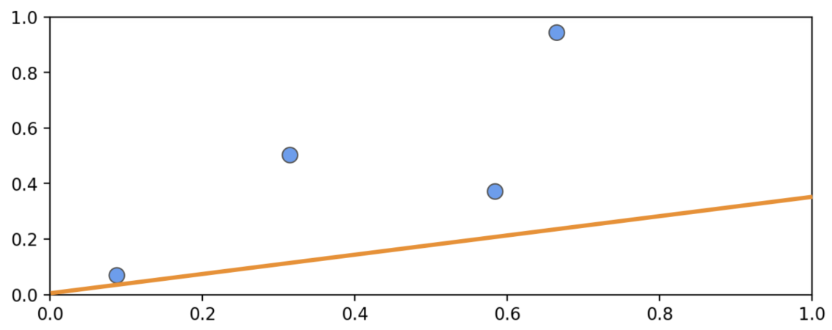
We understand we want to minimize the overall distance from the points to the line

Slide 12
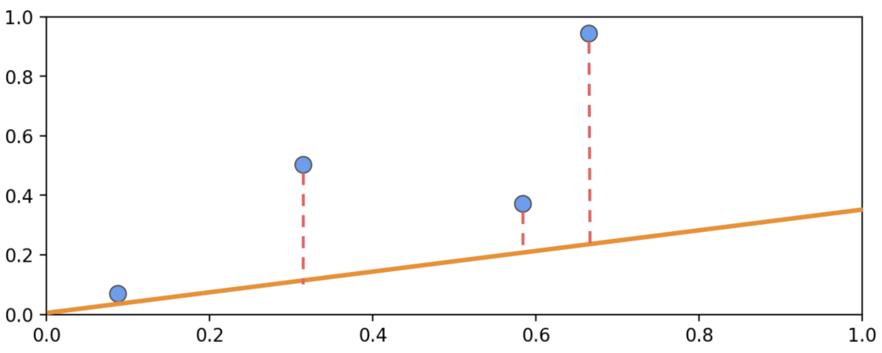
We also know we can measure this error from the real data points to the line, the residual error

Slide 13
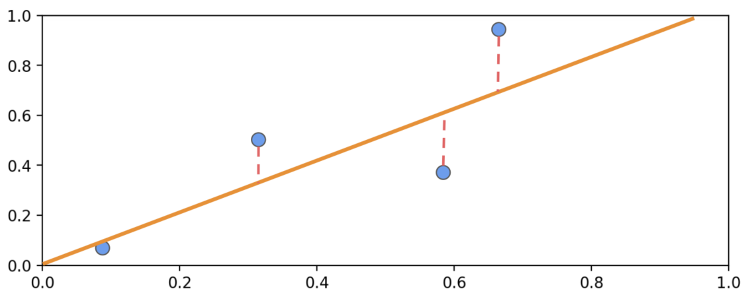
Some lines will clearly be better fits than others

Slide 14
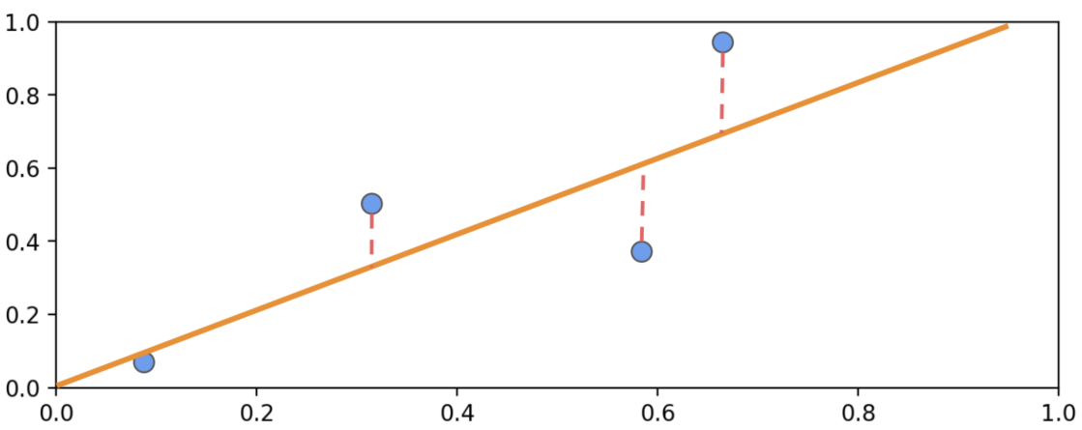
We can also see the residuals can be both positive and negative

Slide 15
Ordinary least squares (OLS) works by minimizing the sum of the squares of the differences between observed dependent variable in the given dataset and those predicted by the linear function

Slide 16
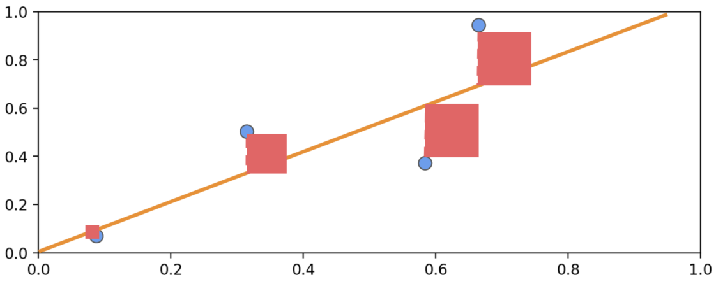
We can visualize squared error to minimize:

Slide 17
A simple straight line is y = mx + b
where m is the slope
b is the intercept with y-axis
We can see for y = mx + b, there is only room for one possible feature x

Slide 18
OLS will allow us to directly solve for the slope m and intercept b.

Slide 19
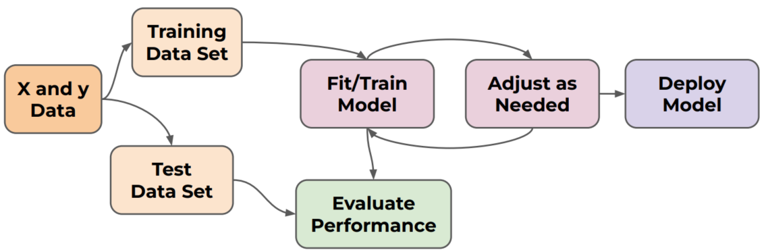
Recall and understand the process of machine learning modeling

Slide 20
Thank you very much for listening.

